Slide 1
Leverage Einstein Vision to Categorize Your Photos
Phil Bergner, Product Lead
Synaptic AP
Notes:
Familiar with Einstein APIs?

Slide 2

Phil Bergner
Youreka Product Lead
Developing on the Salesforce platform for 8 years with Synaptic AP
Architect for our mobile workforce AppExchange product
http://www.youreka.io
Utilizes Einstein to help customers in the field classify photos automatically via our mobile app
200k+ end users
Notes:
none

Slide 3

Forward-Looking Statement
Statement under the Private Securities Litigation Reform Act of 1995
This presentation may contain forward-looking statements that involve risks, uncertainties, and assumptions. If any such uncertainties materialize or if any of the assumptions proves incorrect, the results of salesforce.com, inc. could differ materially from the results expressed or implied by the forward-looking statements we make. All statements other than statements of historical fact could be deemed forward-looking, including any projections of product or service availability, subscriber growth, earnings, revenues, or other financial items and any statements regarding strategies or plans of management for future operations, statements of belief, any statements concerning new, planned, or upgraded services or technology developments and customer contracts or use of our services.
The risks and uncertainties referred to above include – but are not limited to – risks associated with developing and delivering new functionality for our service, new products and services, our new business model, our past operating losses, possible fluctuations in our operating results and rate of growth, interruptions or delays in our Web hosting, breach of our security measures, the outcome of any litigation, risks associated with completed and any possible mergers and acquisitions, the immature market in which we operate, our relatively limited operating history, our ability to expand, retain, and motivate our employees and manage our growth, new releases of our service and successful customer deployment, our limited history reselling non-salesforce.com products, and utilization and selling to larger enterprise customers. Further information on potential factors that could affect the financial results of salesforce.com, inc. is included in our annual report on Form 10-K for the most recent fiscal year and in our quarterly report on Form 10-Q for the most recent fiscal quarter. These documents and others containing important disclosures are available on the SEC Filings section of the Investor Information section of our Web site.
Any unreleased services or features referenced in this or other presentations, press releases or public statements are not currently available and may not be delivered on time or at all. Customers who purchase our services should make the purchase decisions based upon features that are currently available. Salesforce.com, inc. assumes no obligation and does not intend to update these forward-looking statements.
Notes:
Key Message Salesforce is a publicly traded company. Customers should make buying decisions only on the products commercially available.
Talk Track Before I begin, just a quick note that you should base your purchasing decisions on products and services that are currently available.

Slide 4

What you’ll learn today
What is Einstein Vision?
How to prepare photos, upload photos, and train Einstein
A quick demo of Einstein Vision in action!
Next steps you can accomplish on your own
Notes:
Object detection vs classification
NLP: Sentiment,intent
New OCR one?

Slide 5
What is Einstein Vision?
The Einstein Vision API allows you to classify photos based on your own categorized images.
You upload categorized sample images
You run a few commands to train Einstein
You’re done! Now you can send images via an API callout and get back results!

Slide 6
How can I use it?
Let’s consider how it may be useful in several industries:
Expedite site inspections – an on-site inspector could classify mold immediately
Product compliance –verifying brand compliance or product placement
Assist field service technicians – a technician could classify parts, or quickly check inventory for a specific part
Notes:
Don’t have to be SME
Store audit
Build part catalog, build on top of that with API for inventory

Slide 7
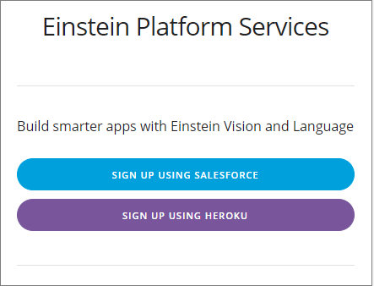
1. Register
First we need to create a user for Einstein https://api.einstein.ai/signup
After registering you’ll be provided a RSA Private key.
Since this user is for DEMO/TESTING ONLY you can copy the key and all of its text to a text file for now.

Slide 8
2. Install an unmanaged package to get started
https://github.com/pbergner/df19-einstein-vision
Note: this package includes bootstrap code to help get you up and running quickly as well as other assets from this presentation
Notes:
Unmanaged package
Good starting point, sample page

Slide 9
3. Take lots and lots of photos!
This is your chance to prove you really are the amateur photographer you say you are on your online dating profile
Create a folder for each photo category and upload sample photos to each
Photo Tips
Include a wide variety of images
Lots of different angles and backgrounds
Color and black & white
Blurred
That contain objects it might typically be seen with
Notes:
Not just sterile photo of a part on your desk
Example later will be residential dryer repair
Relevant for how it will be in the field
Models only as good as you train them to be

Slide 10

Time to Train Einstein
Yes we can teach him a thing or two.

Slide 11
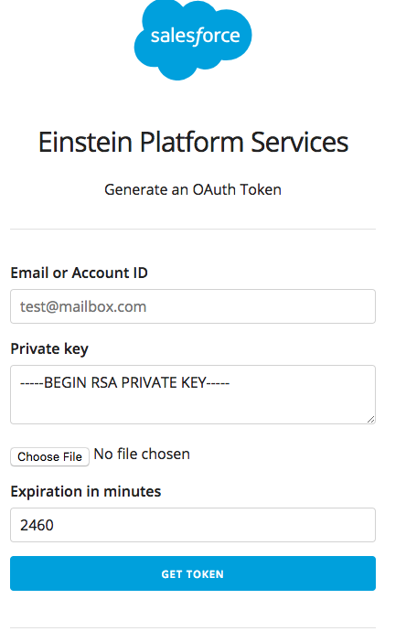
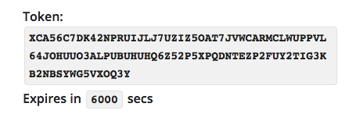
4. Generate an OAuth Token
You only need to do this to train the model. The unmanaged package will handle this going forward
https://api.einstein.ai/token
Enter your email address and paste in the key from earlier
You don’t need to upload a file since we’re pasting the key in
Set the expiration time
It will then generate a token you can copy into a text file for now.
Notes:
Few pieces of information
Just put a big number
Auth token for command line callouts to train einstein

Slide 12
5. Upload your photos to Einstein
Put on your hacker hat, we’re going in!
Does using the command prompt make you cooler?
Yes
Upload your photos to Einstein
ZIP up your folders containing your sample photos
Open a command prompt and consult the Einstein cheatsheet for the UPLOAD command.
Replace the Bearer token with the token we just copied from the previous slide. Replace the path with the local path to your ZIP file.
Click enter!
Notes:
Created a cheatsheet for you
DE has a more complex UI example
Looks intimidating, lots of it is boilerplate

Slide 13
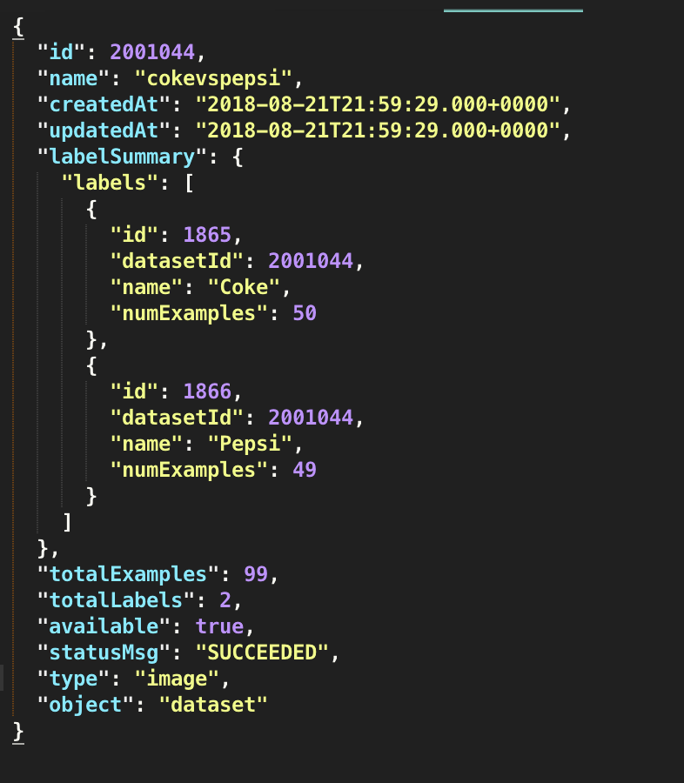
6. Copy your dataset ID from the result
Your result may not be formatted this nicely, but the ID is repeated several times.
Notes:
Reference number for uploaded photos, used for next step

Slide 14
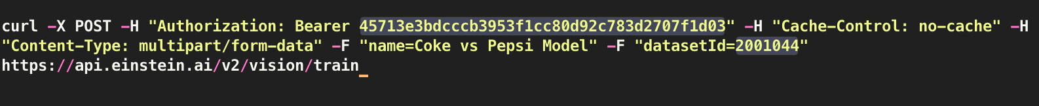
7. Train your Dataset
Einstein isn’t that smart….yet
Train your dataset now that it has your sample photos
Open a command prompt and consult the Einstein cheatsheet for the TRAIN command.
Replace the Bearer token with the token just like before. Give the model a name. Replace the sample datasetId with the one we just received.
Click enter!
Notes:
Get fancy with parameters available, today going with defaults

Slide 15
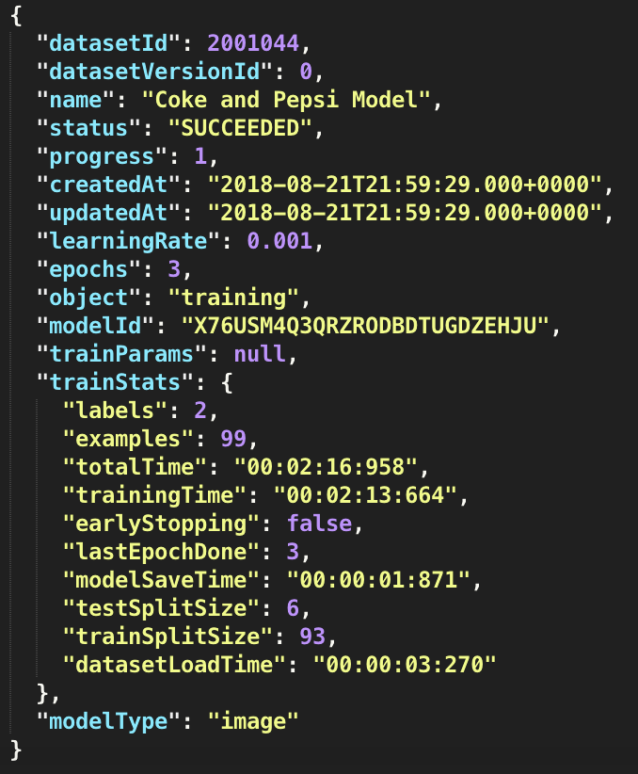
8. Copy your model Id from the result
This is the model Id you’ll be using to test your photos! Copy it and put in a safe place, like your sock drawer next to your Pokémon cards.
Notes:
Did we just train Einstein in a few commands?
Going to be used in all of our future API calls

Slide 16
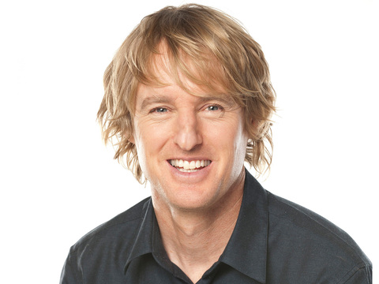
What did we do?
A quick recap of training Einstein
Wow
UPLOAD Images
DATASET ID
TRAIN Dataset
MODEL ID

Slide 17
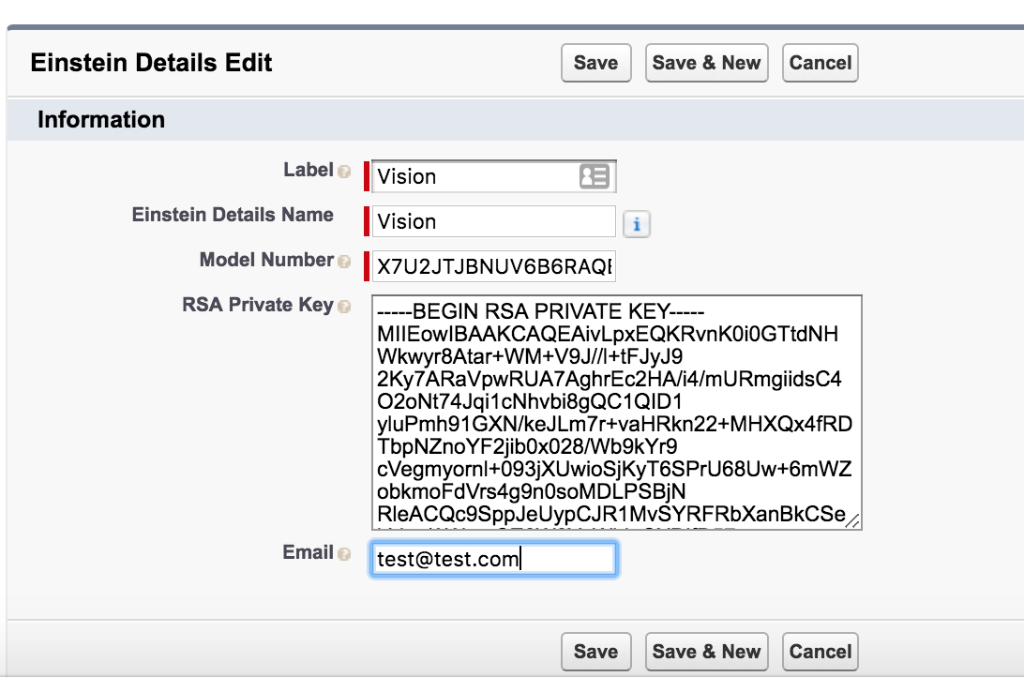
Navigate to the Einstein Details Custom Metadata
I’ve created a handy custom metadata type to store our Id and key.
Paste in your RSA Key, Model Id, and Email.
Notes:
Configuration where you’ll plug everything in

Slide 18
Time to test it out!
For the purpose of this demo I’ll play the role of a field service technician performing a residential dryer repair.

Slide 19
Next Steps
I’ve included a method for using the Feedback API
That’s right you can teach it to get smarter the more you use it!
For a challenge, try adding a button to the page to tell Einstein if it was correct or not. Use the method I provided to make the API call.
Once you’ve given it a good amount of feedback use the RETRAIN command from the cheatsheet to generate a smarter model!
Notes:
Mention what to do if result was incorrect , try again, etc.

Slide 20

Thank you!
This was an example of how simple it can be to configure Einstein Vision with your OWN photos and immediately begin using it.
https://github.com/pbergner/df19-einstein
Includes:
Einstein command cheatsheet
Slidedeck
Trailhead links
Einstein API links
Phil Bergner Youreka Product Lead phil.bergner@synapticap.com @philleebe

